Slide 1
Tommy
I am going to the cinema with Aunty Deb and my cousins.

Slide 2
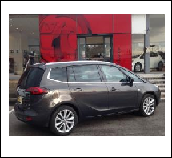
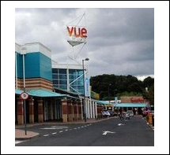
Going to the cinema
First Aunty Deb will drive to my house and I will get in her car.
Then we will drive to the cinema.

Slide 3
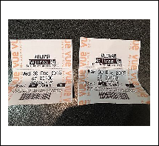
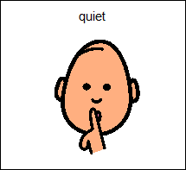
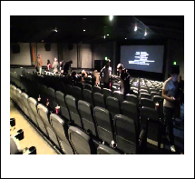
At the cinema
We will buy our tickets and find our seats.
Everyone has to be quiet when the film is on. I will try to be quiet while we are watching the film.

Slide 4
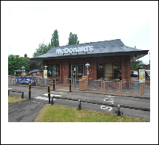
After the cinema.
When we have finished at the cinema we will get into Aunty Deb’s car.
Then we will drive to McDonalds.

Slide 5
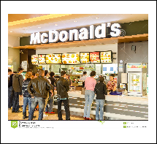
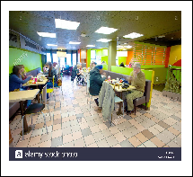
At McDonalds
At McDonalds we will buy our meal and sit down.
Then we will eat our meal.

Slide 6
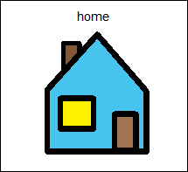
After McDonalds
When we have finished eating and drinking we will get back in Aunty Deb’s car.
Then we will drive back to my house. When I get home my Dad and my brother will be there.

